Slide 1
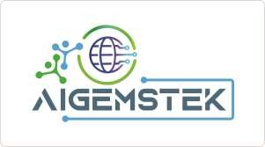
AI GEMSTEK PVT LTD
Powering the FUTURE GEN’s

Slide 2
AI GEMSTEK PVT LTD
Vision
Strive for Continuous Growth. Lead Indian Market.
Impact the World.
Mission
We commit to the growth and success of our clients, portfolio companies and professionals, with a special focus to grow future leaders in India.

Slide 3
ABOUT US
Powering the Future
About AIGEMSTEK
Innovation Focus
ISO 9001:2015 certified
Investigation, exploration, design & testing services
Think global, act local
Works with engineering, utilities & service sectors
Commercialization of SMRs/MMRs
Automation-driven engineering
AI/ML & robotic service assistants
Strengthening global energy security
Impact & Vision
Energy Landscape
Clean, affordable, reliable energy
Enabling decarburization goals
Supporting energy independence
Shaping tomorrow’s energy demand
Global energy demand to double by 2030
25% population growth in the next 20 years
Increasing decarburization pressure
Nuclear = only scalable, safe, carbon-free energy source

Slide 4
About Us:
AIGEMSTEK is one of leading and fastest growing management consulting firm in India , with more than 20 years of experience in the business.
We collaborate with visionary leaders to help you enter India’s culturally diverse market with adaptive strategies. As the leading India market entry firm, we have helped some of the world’s strongest brands enter and expand in India with opening offices, setting up manufacturing facilities, acquisition of local players and hiring the right talent.
Our customized India-centric services, backed by experienced teams of business consultants, have consistently helped clients expand their footprint in the country and bring world-class products and services to India.
Our team comprises of experts from various industries and functions, with strong business acumen and problem-solving skills to provide actionable and timely solutions to clients.ye

Slide 5
SERVICES:
RESEARCH & STRATEGY AND TARGET MARKET
Market Research
Competitor Bench Marking
End User Analysis
Go-to-Market Strategy
Corporate Services:
Office set up
Company Incorporation
Corporate secretarial Support
Accounting and Bookkeeping
PR and strategic communications
Human Resources Management:
Key Team Identification and Deployment
Recruitment
PEO/EOR/Incubation

Slide 6
Factory Setup:
provides end-to-end solutions for business start-ups – right from forming an Indian entity, location identification, drafting a business plan, vendor selection and recruitment to project management.
We completely understand and comprehend the fact that any hurdle in the process could have higher ramifications, including bearing losses and losing a competitive edge. Given a strong understanding of regulations, tariffs, taxation policies and a robust network with government bodies (both Central and State), we ensure a seamless implementation plan for the clients. Site selection identifying and evaluating potential factory locations, taking into account factors such as transportation infrastructure, access to skilled and unskilled labor and zoning laws.
Site Selection Facility Design
Equipment and Machinery Procurement
Installation and Commissioning
Hiring and Training
Compliance

Slide 7
AIGEMSTEK acts as the owner’s engineer through efficient project management which meets following objectives:
Right Location and Site
Project Cost Control
Project Timeline Control
Fully compliant with All Regulations
Efficient Resource (Capital and human) and Vendor Management
Efficient Project Management
Efficient Cash Flow and Fund Management
Project Safety Requirements
Project Quality Requirements

Slide 8
Value Addition through Manufacturing Setup Service
End-to-End Project Management with a focus on Cost and Time control
Cut the Project Gestation time by 25 to 30%
One Stop Vendor Management
Unbiased Identification and Evaluation of Vendors
Reduce Clent Resource Deployment Time by 50-60%
One Stop Solution for Different Vendor Deployment
Effective and Efficient Decision making to Overcome any Hurdles
Seamless Communication
AI Tools and performance dash board

Slide 9
Mergers & Acquisitions:
End-to-End Execution of Cross Border Deals
By the virtue of working with clients across varied sectors, including a number of Indian companies – privately held, family-owned, and public – we have been able to garner experience and understand the intricacies of executing transactions or partnerships in India. Our main aim is to ensure that our clients can get fair deals and enough business opportunities in India. With a team of highly experienced Merger & Acquisition (M&A) professionals, Aigemstek has successfully assisted numerous clients in structuring and executing a wide range of complex transactions.
‍Reduced risk: We have had the experience – over a period of time – in dealing with post-closure issues (reasons why 50% of all deals fall through, if not handled well).
‍Experience of working with Indian companies– More than 90% of Indian companies are family-owned – we understand the importance of developing a long-term engagement and being their confidant.

Slide 10
‍Key focus on inbound deals– We have over two decades of experience in helping foreign companies partner with/acquire Indian companies.
We are one of India’s finest mergers and acquisitions firms who work as sole transaction advisors to our clients – from identifying and qualifying targets to structuring and closing deals, and 100% post-deal integration. We have helped many companies to exit unfavorable/ hostile agreements as well.
Identifying and Qualifying Targets
Structure and Negotiating Deals
Due Diligence
Post-Acquisition Integration
Overview of our Mergers and Acquisitions Services:
Stage-1 Deal Preparation
Stage-2 Structuring and Negotiations
Stage-3 Due Diligence and Closing
Stage -4 Post –Acquisition Integration

Slide 11
Sourcing and Supply Chain Management:
ndia has emerged as a strategic sourcing hub for global companies, driven by its vast manufacturing ecosystem, skilled workforce, and cost competitiveness. As businesses seek to de-risk global supply chains and enhance operational agility, the role of expert sourcing and supply chain management consulting firms in India has become more critical than ever.
Tecnova’s India Sourcing and Supply Chain Management services are a suite of services designed to help foreign companies source products and services from India and manage their supply chains more efficiently.
AIGEMSTEK a leading India entry and expansion consulting firm, offers specialized Sourcing and Supply Chain Management services tailored to global businesses looking to leverage India’s advantages. With decades of experience, We enables companies to identify reliable suppliers, optimize procurement strategies, and manage end-to-end supply chain operations in India.

Slide 12
India Sourcing and Supply Chain Management services include:
Supplier Selection and Management
Vendor Development
Production Planning and Scecheduling
Inventory Management
Transportation and Logistics
AIGEMSTEK Sourcing and Supply Chain Management Services benefit our clients:
By reducing costs
By improving quality
Increasing supply chain visibility and control
Improving customer service
Gaining access to new markets and suppliers.
AIGEMSTEK leverages its deep market knowledge and strong supplier network to deliver successful sourcing solutions across industries like Cables, automotive, electronics, telecom, Power T&D, EV segment, Solar EPC and consumer goods. Our experienced team ensures improved supplier performance, better inventory control, and faster time-to-market—turning the complexity of India’s supply chain into a strategic advantage for global businesses.

Slide 13
COMMERCIALISATION:
Distribution Partner Search to Enter and Expand in India
Having conducted various projects in India, AIGEMSTEK has a strong database as well as a network of companies operating across industries (B2B and B2C) and regions.
AIGEMSTEK is a fastest growing business consulting firm that provides distribution partner search services to companies of all sizes, looking to expand into new markets. We have a strong track record of success in helping our clients find the right distribution partners to help them achieve their growth goals.
Secure the Ideal Distribution Partner in India with Us:
AIGEMSTEK helps you find the right distribution partner for success in any new market. Our experienced consultants will identify and evaluate potential partners based on your business goals, target market, and product/service offering. We will thoroughly evaluate each potential partner’s financial stability, market reach, sales track record, and customer service capabilities. Finally, we will present you with a list of recommended partners and help you select the one that fits your business needs best.

Slide 14
Value Add through Distribution Partner Search Services:
Access to a large network of qualified distribution partners
Thorough evaluation of potential partners
Expert advice on selecting the right partner for your business
Reduced time and cost of finding a distribution partner
Increased chances of success in your new market

Slide 15
SECTORS:
CABLES AND CONDUCTORS:
General Purpose
Electro mobility
Charging
Connectivity/Data Cables
Extra Flexibility
Weight Reduction
Optical Fiber
Single and multicore Electric Cables
Tailor Made
High Temparature Performance
Applicance & Energy Cables
DEFENCE:
Drones
Robotics- Humanoids
CONSUMER:
Food & Beverages
Personal Care
Other FMCG Products
PHARMA & HEALTH CARE
Medical & Equipment's
Medical Devices
Formulations / Bulk Drugs
Clinical Research
Nutraceuticals/Ayush Products
INDUSTRIAL
Equipment & Machinery
Electronics
General Engineering
Food Processing & Packaging

Slide 16
POWER T&D
Towers/Components Manufacturing
Cold Forms/HDG Items
Tanking
DTR’s/HV/EHV Transformers
Insulators
TECHNOLOGY:
Software/ AI Data Centers
IT Services
Robotics
Drones
AUTOMOTIVE:
Original Equipment Manufactures
Electric Vehicles
Components
REAL ESTATE/CONSTRUCTION:
Housing
Commercial
Tech Parks
Office Spaces
RAILWAYS:
Emergency Lighting Units
Public Address and Passenger Information systems
S&T

Slide 17
SOLAR EPC:
Pre Design
Detailed Engineering Design
Structural Engineering
Site Survey & Feasibility
Permit Design & Compliance
PMC Services
Inspection Services
ENERGY ADVISORY:
Feasibility Studies
Transaction Advisory
EPC Bid Management
Energy Storage
Asset Monitoring
Environmental Engineering

Slide 18


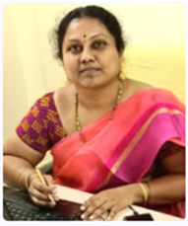
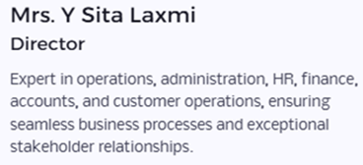
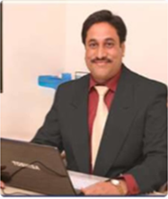
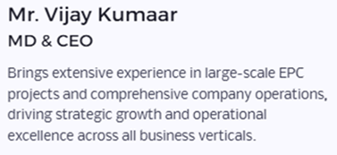

Slide 19

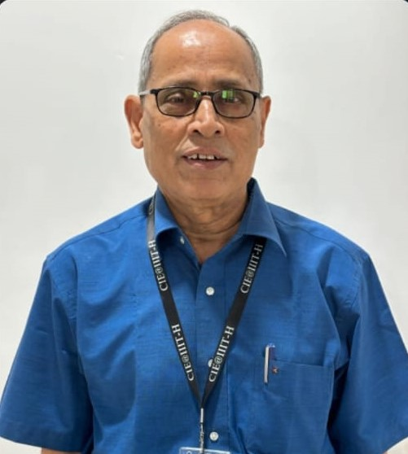
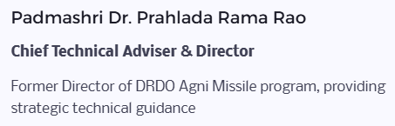
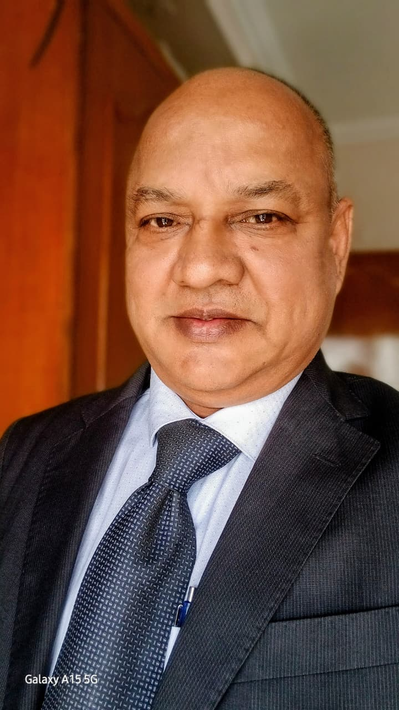
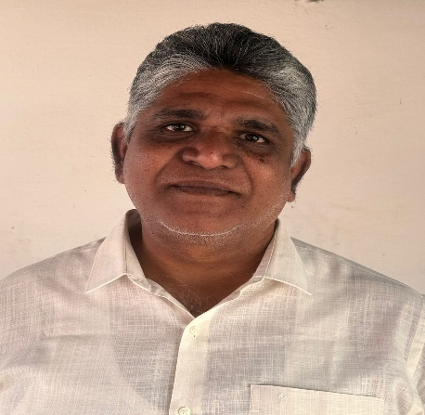
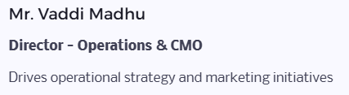
MMr. R. Srinivas
Director Solar EPC & Robotics

Slide 20
Meet our Advisory Board & Chief Consultants
Dr. P. Chandra Shekar Ms, MBA, PhD
Technical Director –Management Consultant – 7S Technologies
Expert in Robotic Engineering
Technical Advisor – Ramoji Film City
Sri. Venugopal Timmaraju
Expert in Designing and fabricating very heavy to Precision equipment for ISRO/ BDL/ RCI/ DRDO and BRAHMO
Trainer productions process improvements, 5S, TQM, TPM, Cost reduction, wastage reduction and Management studies.
Dr. G. V. Rao
Ex Director DMRL
Expert in Composites and Tanking
Our Advisory Board comprises distinguished industry veterans and industry experts who guide us our strategic direction and ensure technical excellence across all initiatives. Their deep domain knowledge strengthens our competitive edge in emerging clean energy markets.

Slide 21


AIGEMSTEK
Meet Our Marketing partners
Sainath Golla
Cables and International Marketing
Shasidhar Muniganti
Expert General Trade
Mr.Sampat Kumar,
Expert Power Plants
Mr.Prasad
Expert Power T&D and EPC
Mr.Chalasani Krishna Prasad
Expert IT
Dr.Mahesh Kandula
Expert-NBD
Environment Vertical Head

Slide 22
Our Focus Areas
AIGEMSTEK
Hybrid Energy Solutions
Solar, Wind and NED&Mills .
Cables and Conductors
Technological Structures Fabrication
Special Structures
Hydrogen Tanks
Reactors , Support Systems
Small Modular Reactors
.
Mobile and Micro Nuclear Reactors
EV Trucks/Vehicles
Technology
Commercial EV Trucks & Off Road EV Dumpers
Humanoid Robots
AI &IOT Projects
AI Data Centers
Railways & Defense
Solar EPC/BESS
Pharmaceuticals/Food Industry
Solar PV Cells , Modules and Mounting Structures and EPC`
Re-Cycling E-B waste

Slide 23
Our Business Verticals
AIGEMSTEK
RESEARCH & STRATEGY
Corporate Services
Mergers and Acquistions
.
Commercialization
Factory Set up/Turnkey Assembly Line Services
Human Resources Management
Sourcing & Supply Chain Management
Hybrid Energy Solutions
Solar/BESS EPC
Technological Structures and Infrastructure Segment

Slide 24
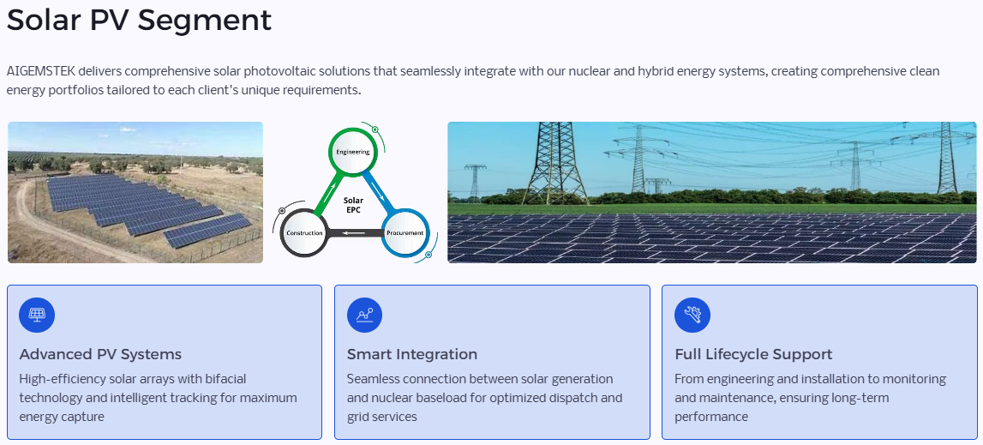

Slide 25
